Slide 1
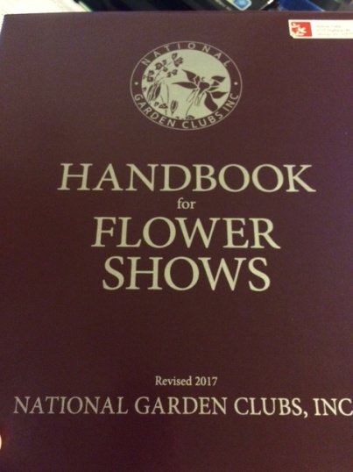
WHAT’S NEW? FSP AND DESIGN CHANGES TO THE HANDBOOK FOR FLOWER SHOWS
Pensacola Flower Show Schools
Symposium-Allied Topic
March 8, 2017
Gina V. Jogan

Slide 2
CHAPTER 1 NGC FLOWER SHOW
NGC Flower Show is title (no longer using NGC Standard Flower Show)
Five (5) possible divisions :
Horticulture (required)
Design (required)
Education (optional)
Youth/Sponsored Groups (optional)
Botanical Arts (optional)

Slide 3
Basic requirements-changes
Schedule must be written and mechanically printable and include specific wording and all essential details.
Subdividing in Horticulture: usually three (3) or more exhibits of botanically identical, or similar in form, color, size or description to justify forming a subclass.
Judging panels: 2 accredited and 1 plant society judge, or one recognized horticulture or fine arts professional (Photography is exception)

Slide 4
Basic requirements-changes
Ribbons or seals may be offered in the FS, but should be uniformly used throughout all divisions.
All non-blue ribbon exhibits scoring 90+ must be so designated on the entry tag and signed/dated by an NGC judge on the panel.

Slide 5
New Specialty Flower Shows
Horticulture Specialty Flower Show:
Must have minimum of 10 horticulture classes
Minimum of 40 exhibits is required
May offer all NGC Top Exhibitor Horticulture Awards
At least 2 exhibits in any combination of Education, Garden and/or Youth must be included.
Botanical Arts Horticulture and/or Photography exhibits are permitted.
Eligible for the Horticulture Specialty FS Achievement Award
No design exhibits are permitted.

Slide 6
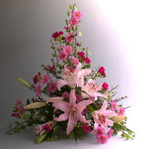
Design Specialty Flower Show
Must contain a minimum of 10 design classes with a minimum of 4 exhibits in each (40 designs)
All NGC Top Exhibitor Design Awards may be offered
Must include at least 2 exhibits in any combination of Education and/or Youth
Artistic Crafts, Botanical Designs and/or Photography Exhibits are permitted in the Botanical Arts Division.
Eligible for the Design Specialty FS Achievement Award….no horticulture exhibits are allowed.

Slide 7
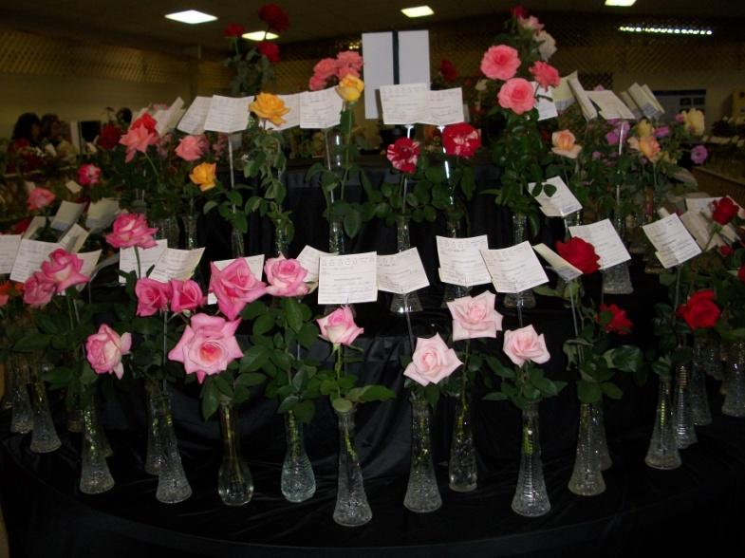
Changes: Categories of Flower Shows
General Show
Petite Show
Holiday and/or Patriotic Shows
Shows co-sponsored with plant societies
Major Flower Shows

Slide 8
Changes to Writing the FS Schedule
Specific formatting is required
Specific rules must be stated in full in all five possible divisions.
Study and follow chapter 2 in the new HB

Slide 9
Changes to AWARDS
Each designated section must consist of 3 or more classes.
Unlimited number of TEA are available for exhibits in the Horticulture, Designs and Botanical Arts Divisions
Three Club Competition Awards may be offered: Horticulture (displays only), Design (Floor Designs, Functional Tables for 4+, or Vignettes) and Botanical Arts (Gardens).
Added: Botanical Arts Artistic Crafts Award, Botanical Arts Design Award. Botanical Arts Horticulture Award, Botanical Arts Garden Award and Botanical Arts Photography Award.

Slide 10
Changes: Design
New terminology: American Traditional Line, Line-Mass or Mass Designs.
Sizes: Petite designs are 3”-12” in HWD and Standard designs are 12” or more in HWD.
Tables are either Functional or Exhibition type
Designs are either standard or advanced.
All plant materials used in design must be listed on card and placed with entry tag.
Background panel is now called staging panel or background only.
New designs: Cascade, Featured Plant Material, Challenge, Grouped Mass and Low Profile Designs

Slide 11
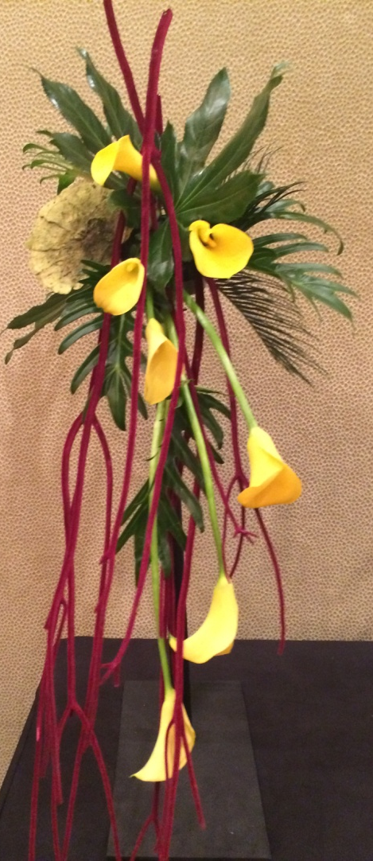
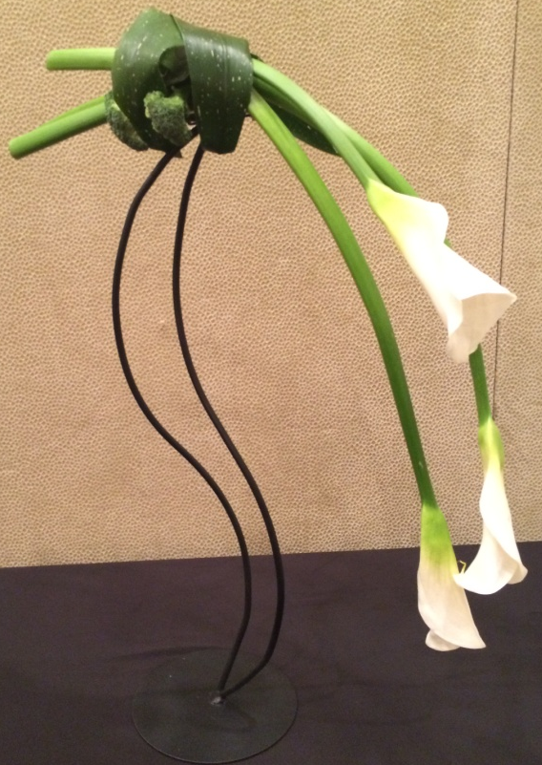
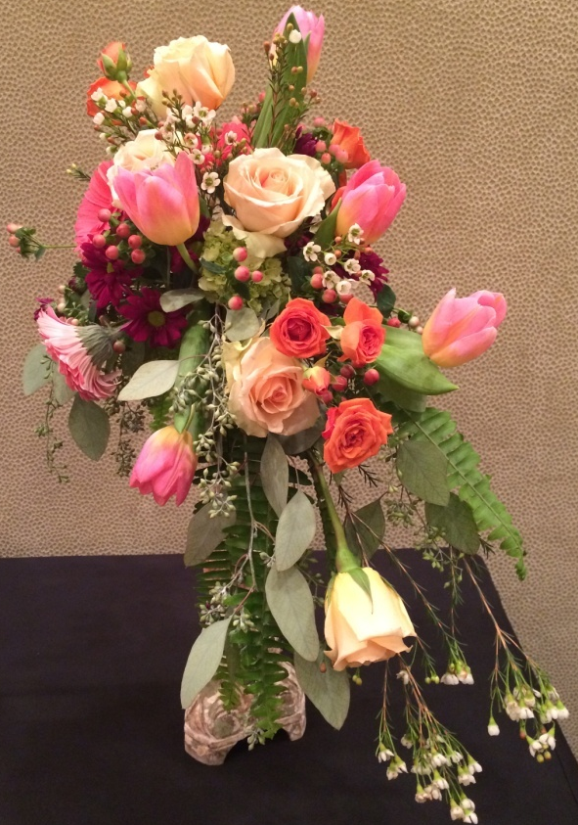
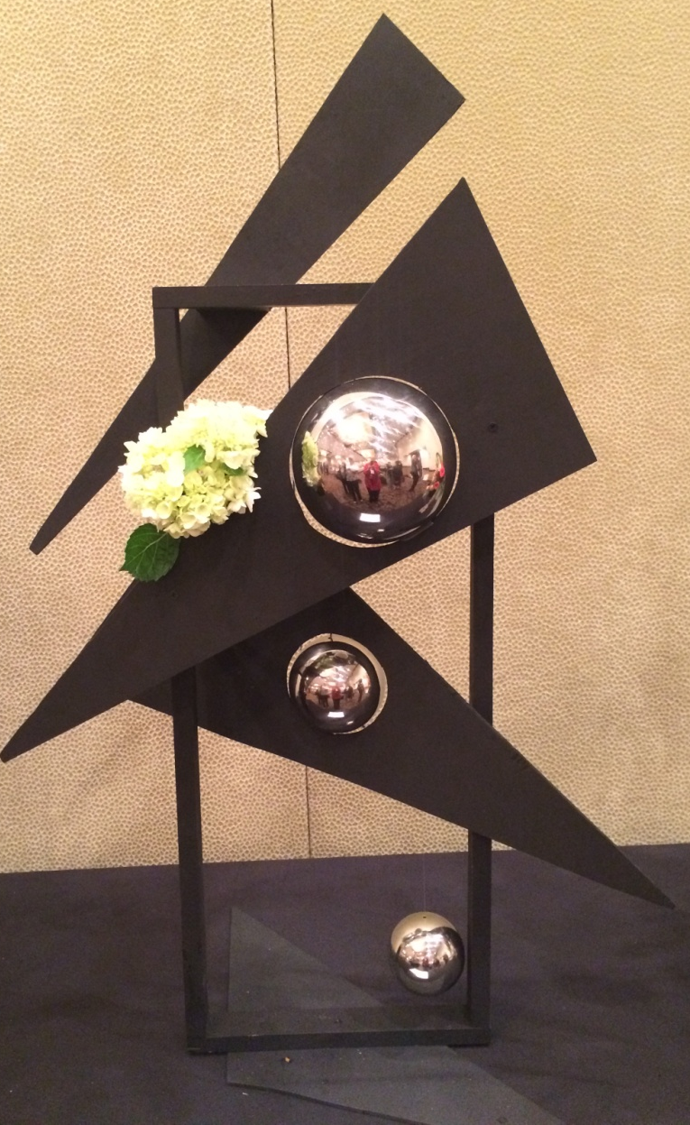
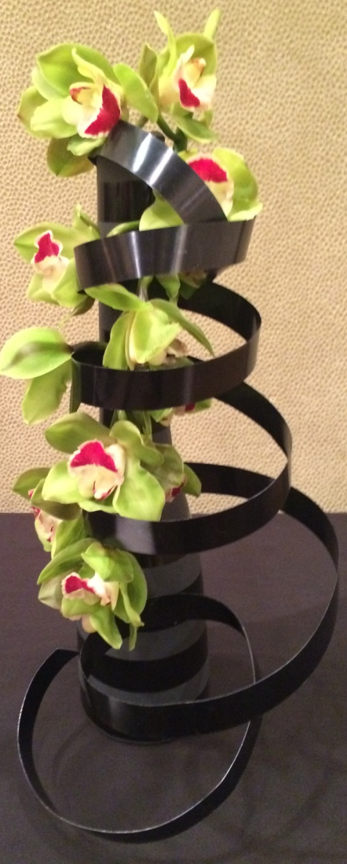
CASCADE Design

Slide 12
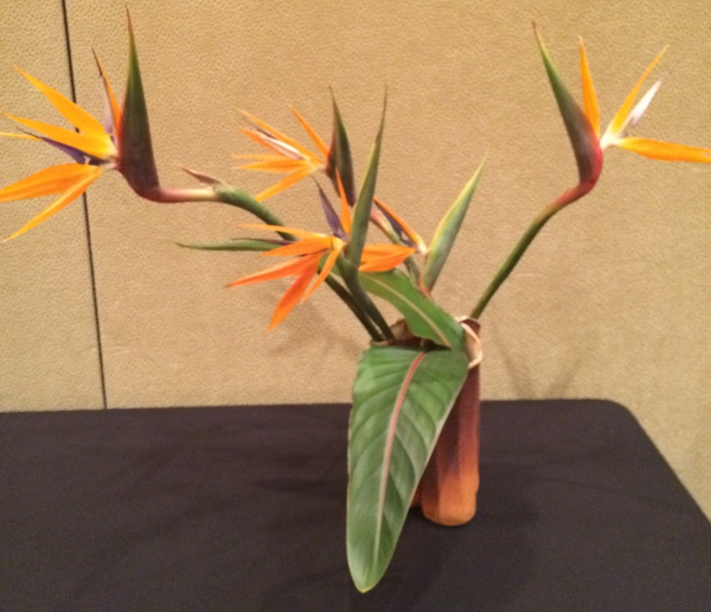
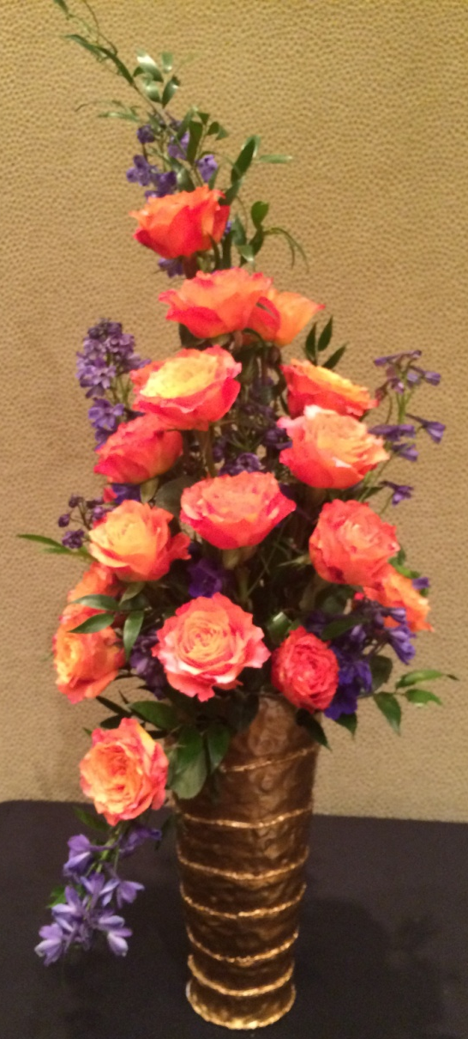
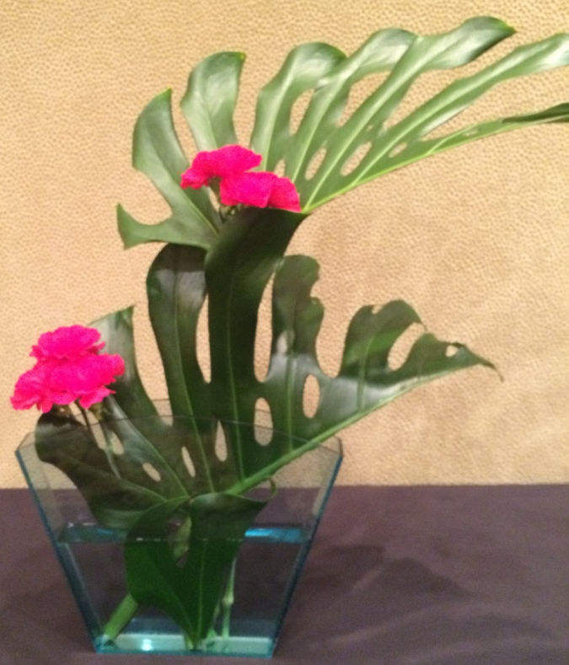
FEATURED PLANT MATERIAL Design

Slide 13
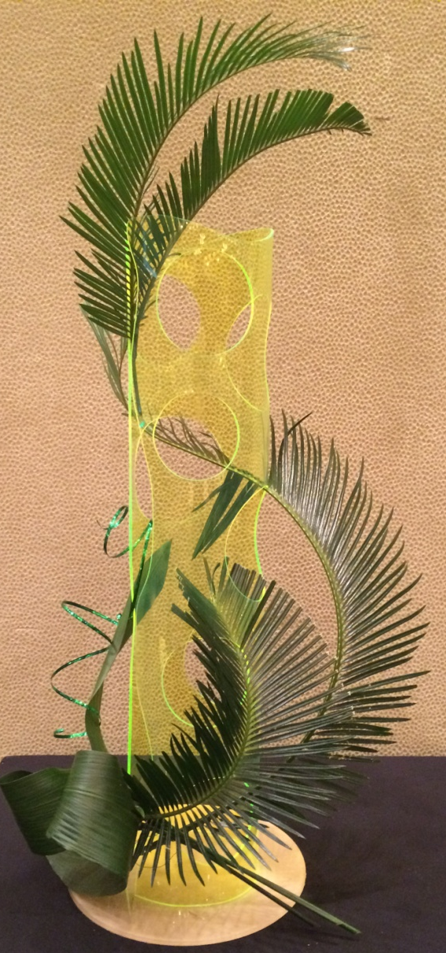
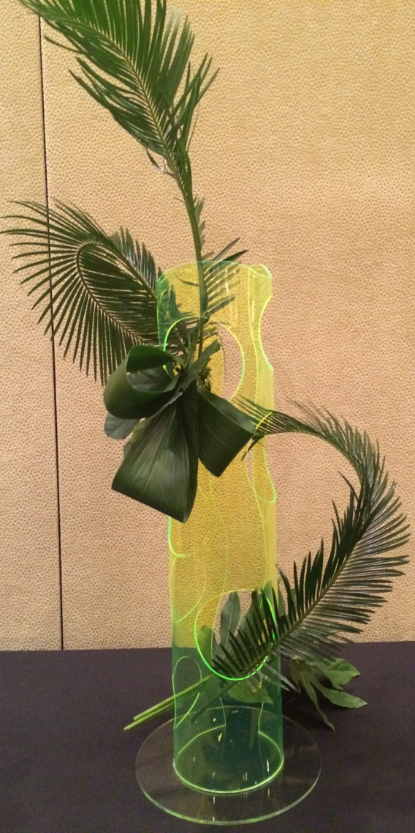
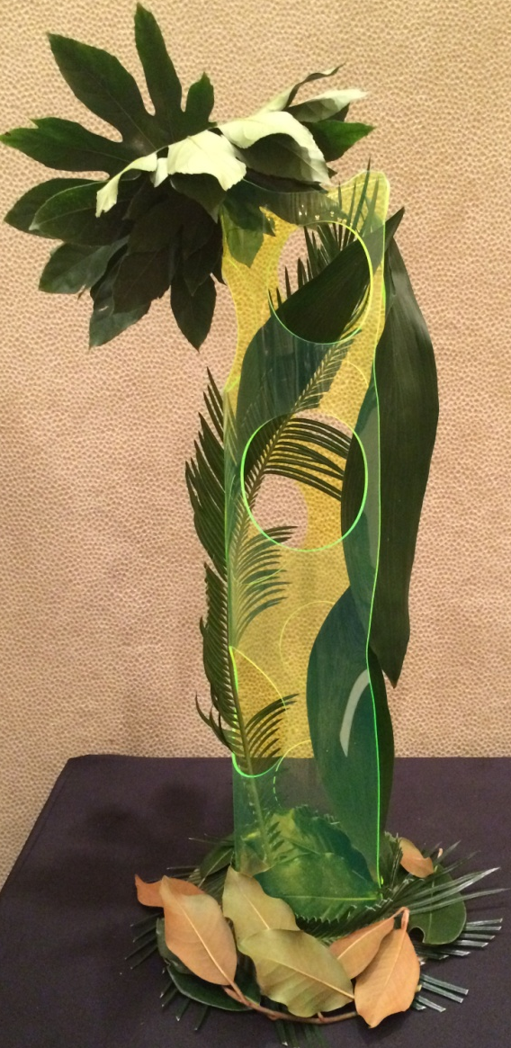
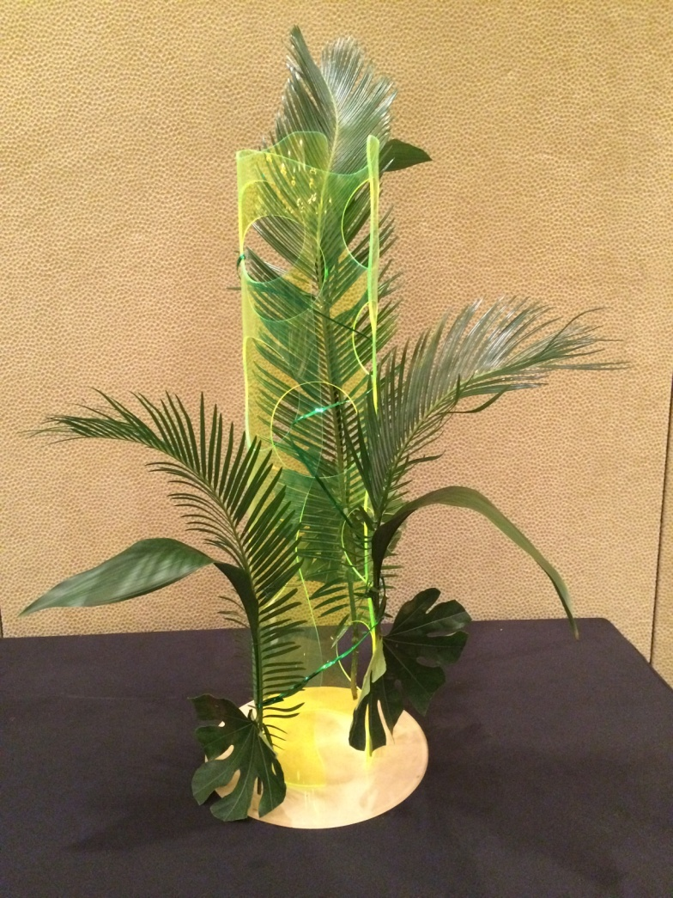
CHALLENGE Design

Slide 14
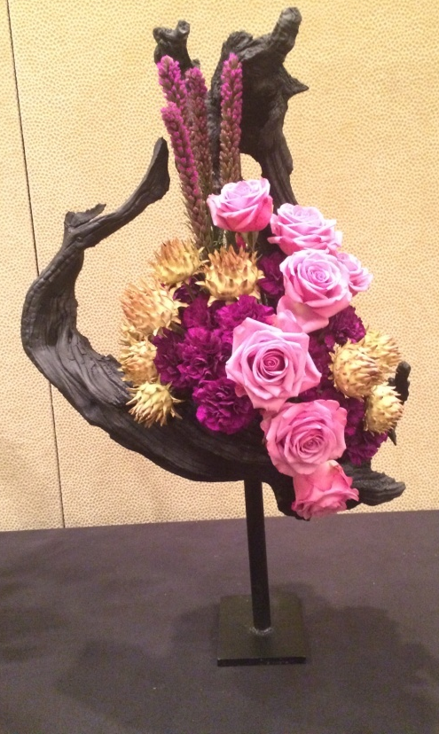
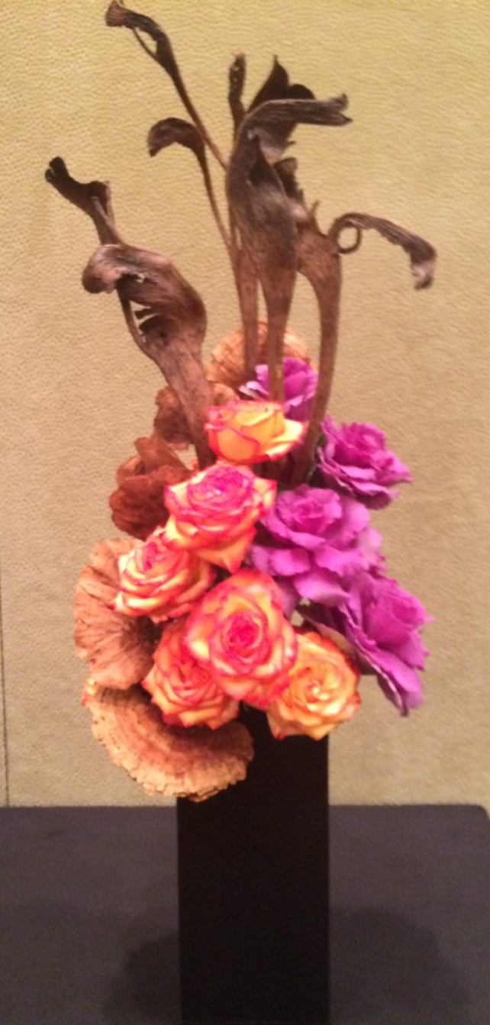
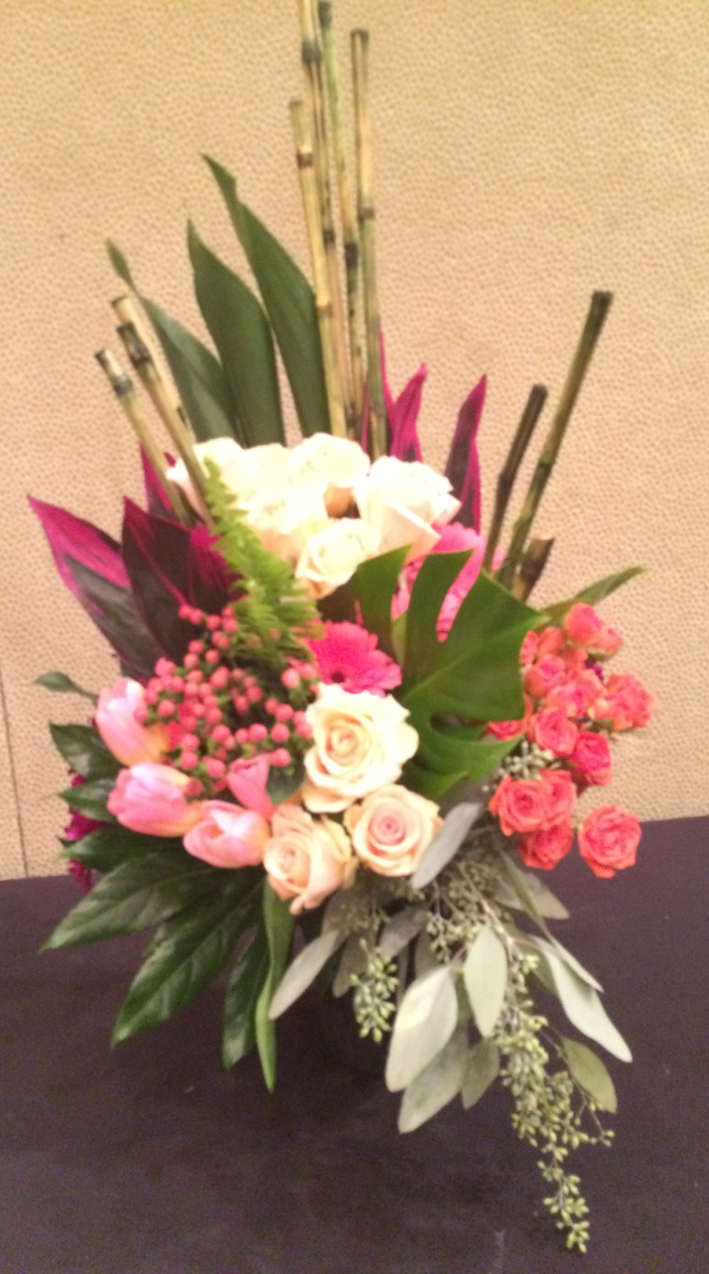
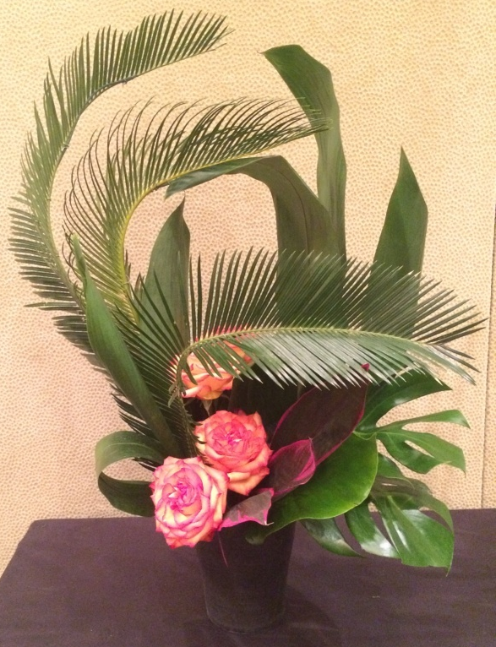
GROUPED MASS Design

Slide 15
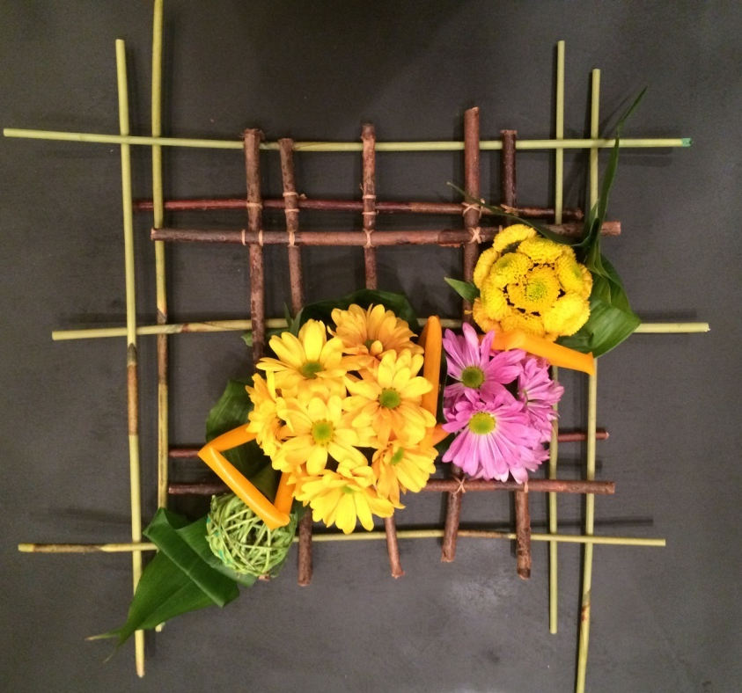
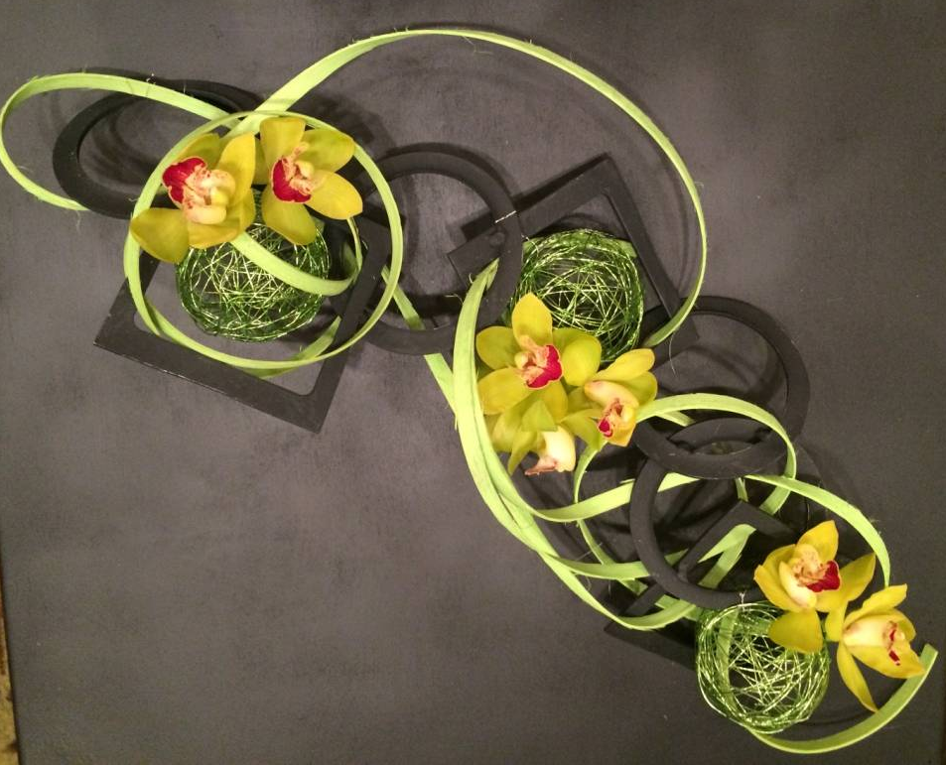
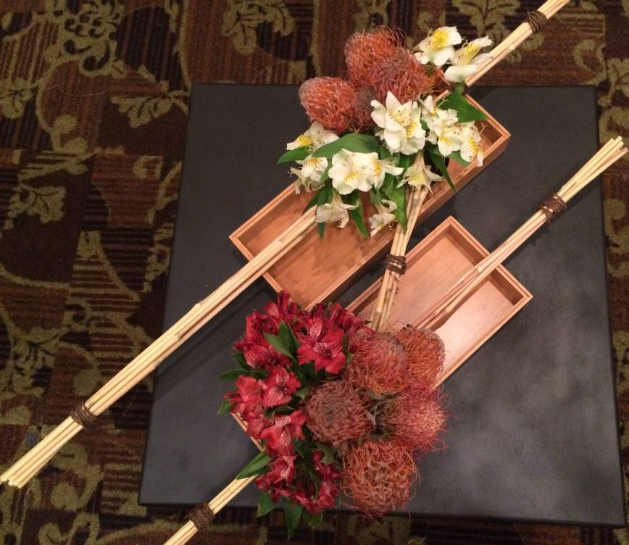
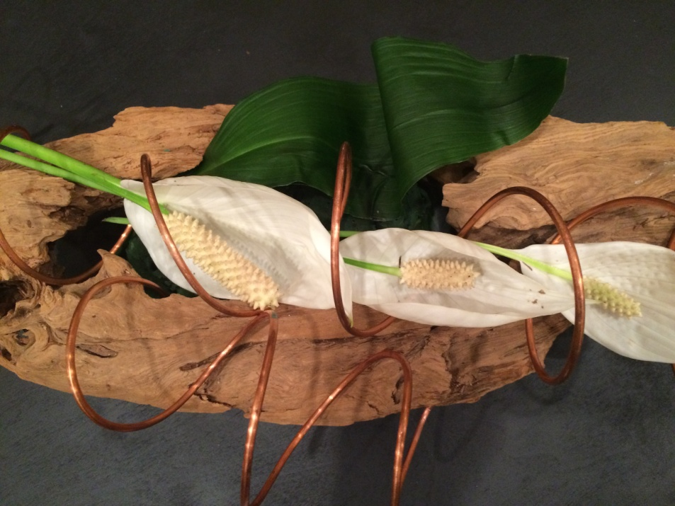
LOW-PROFILE Design

Slide 16
Botanical Arts-Design
Bonded Designs: collage and plaque
Hanging Designs: traditional or creative, such as wreaths, swags, garlands, etc. includes mobiles
Pot-et-fleur and Topiary are now in Botanical Arts-Design.
Exploration Designs-Freedom to explore; no limitations; no plant restrictions;

Slide 17
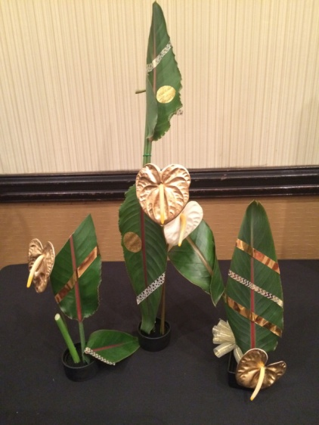
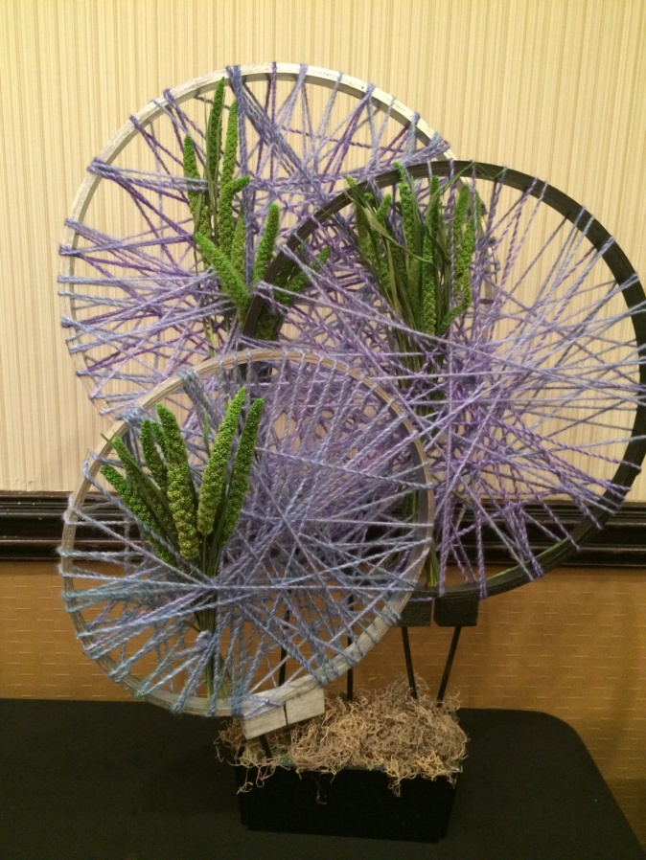
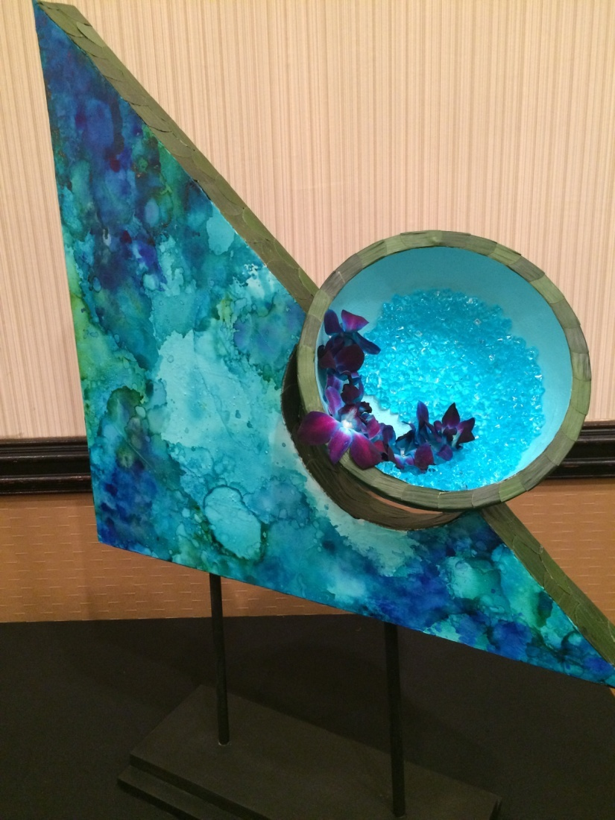
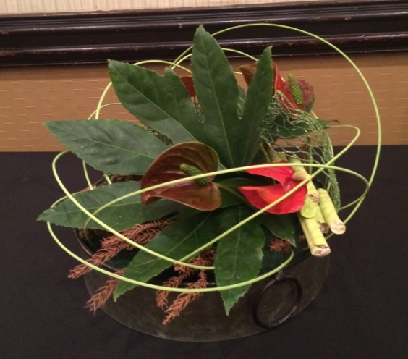
EXPLORATION-Freedom of Style

Slide 18
Changes: Point Scoring and Judging
We no longer have to add up faults and divide to find the Distinction value. Address components, mechanics, craftsmanship, etc.
Student Schedules must score 75 in order to pass. Students have 6 months to complete schedule.
Master judges now have to enter, earning 1 ribbon each in Hort and Design AND judge 1 Small Std. FS or Specialty Show or serve on a FSS or Symposium Master Panel….the passing grade completed Point Scoring form must be signed by the instructor.

Slide 19
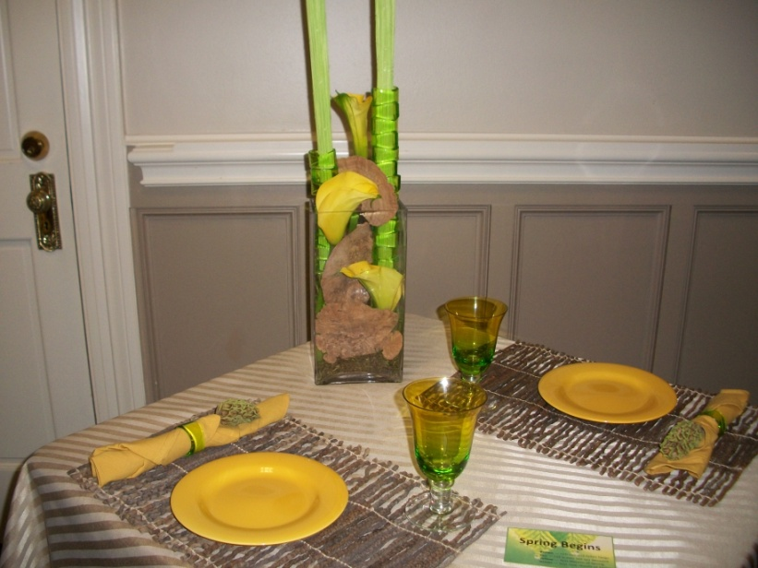
Changes in Curriculum
All students must begin with Course 1
FSP will concentrate on intro to the Handbook and schedule writing.
Tables will now be taught in Course 2 Design.

Slide 20
Changes: Scales of Points and Glossary
Horticulture changes
All Designs have one scale of points however, values have changed and comments MUST be made in every category
Glossary is all inclusive now without sections for each division.

